Slide 1



Team FinHack
NBS BAC x Deloitte Business Analytics Hackathon 2022

Slide 2
Executive Summary
Macro Outlook
Problem statement and Objectives
Common fraud and Risk profiles
Data used and limitations in analysis
Analytics and Insights
Data mining applications used
9 Frauds detected
Qualitative and quantitative analysis of frauds present
Recommendations for financial loss minimisation and prevention
Regulations and Smurfs
Money Laundering overview
Local Regulatory legislations, historical, current and future strategies to counteract Money laundering
Frame work, dataset required and methodologies required in Smurf detection
Sources: HSBC
Notes:
Qing Rui

Slide 3
01
The Scope

Slide 4

Prevalence of Fraud
Context: Possible existence of Internal and External Fraud pointed out by whistleblower that individuals related to the banks are using accounts payable, employee expenses and corporate credit cards to fraud the company.
Problem Statement: These Frauds are allegedly easy to execute and may cost the company greatly in the long run as financial and reputational risks are involved.

Slide 5
Strategic defrauding through objectives
Key objectives:
To analyze the datasets given on accounts payable, corporate credit cards and payroll with inter-dataframes comparison resulting in identification of ghost and duplicated employees accounts
Highlight possible fraudulent transactions and individuals with suspicious activity with visualization across countries through geospatial data to track discrepancies in cash outflow
Quantify current fraudulent transactions with strategic outline of impacts and recommend solutions to deter such problems in the future to result in tailwinds for efficient fraud management

Slide 6
Common Fraud in the Market
Credit Card
Payroll
Account Payable
Fictitious expenses
Mis categorization of expenses
Duplicate expenses
Non-arm’s length expenses
Ghost Employee Fraud
Advance Retention Fraud
Pay Rate Alteration Fraud
Compensation Fraud
Check Fraud
Expense Reimbursement Fraud Schemes
Over Billing (Overpayments)
False Billing
Duplicate Invoice Payment
6. Pass-through schemes
7. Disguised Personal Purchases
8. Fake Vendor

Slide 7
02
Interpretation and Risk Profiles

Slide 8
Risk profiles
The data given has been subset into 3 distinct categories, with key fraud identification towards Internal, External and Internal-to-External Stakeholders and Cashflow direction. The various datasets and utilizations are outlined as follows:
Internal-to-External
Internal
Internal-to-External
Dataset: Accounts Payable.XLSX
Dataset: Payroll.XLSX
Dataset: Credit Card Data.XLSX
Expense Reimbursement Fraud (Duplicated report submission)
Billing Fraud (Falsified Billing information)
Overpayments
Ghost Employee Fraud
Pay Rate Alteration Fraud
Unauthorized Employee Fraud
Fake Vendor Fraud
Fictitious expenses
Miscategorization of expenses
Duplicate expenses
Non-arm’s length expenses

Slide 9
03
Analytical Process Flow

Slide 10




Analysis Process
Shortlist Potential Frauds
Data Cleaning
Data Exploration
Quantify Cost
Data Visualisation
Devise Solutions
List potential frauds identifiable from the given data.
Clean data to ensure easier and consistent analysis
Explore data to identify potential frauds listed previously.
Quantify cost of fraudulent activity found.
Visualisation for clarity and presentation
Create long-term solutions to deter the identified fraudulent activity in the future.

Slide 11
04
Data in analysis and Limitations

Slide 12
Limitations
Data used in analysis
Payroll Data:
Employee Master & Payslip sheets
Credit Card Data:
Leave & Transactions sheets
Accounts Payable Data:
Invoice and Vendor Master sheets
No documentation of data (Data Dictionary unavailable)
Lack of several confidential employee information (E.g. names to identify if employee has promoted since employee id changed from XXXXXX to XXXXXA)
Missing vendor and employee information (Inability to reconciliate data across datasets and join tables)
Missing information in timeframe (November Month)

Slide 13
05
The Team’s Analytical tools

Slide 14



Analytical Tools
Data Mining and Discovery
Database storage
Data Visualisation and Storyboarding
Notes:
What analytical tools you used to perform the analysis and why you chose them
R
Accessible for everyone (Open Source Programme)
Ability to use dataframe, SQL, statistical tools and eventually build machine learning model for solutions
SQL
Easy to understand
Easy to use
Structures and data are kept very safe as it is not easily changed.
Can be used within other programming language like R and Python
PowerBI
powerBi is the most commonly used in practice.
PowerBI is also highly accessible to everyone.
Trending dashboarding tool.

Slide 15
06
Key Insights
Outcomes from Data Mining and Analysis

Slide 16
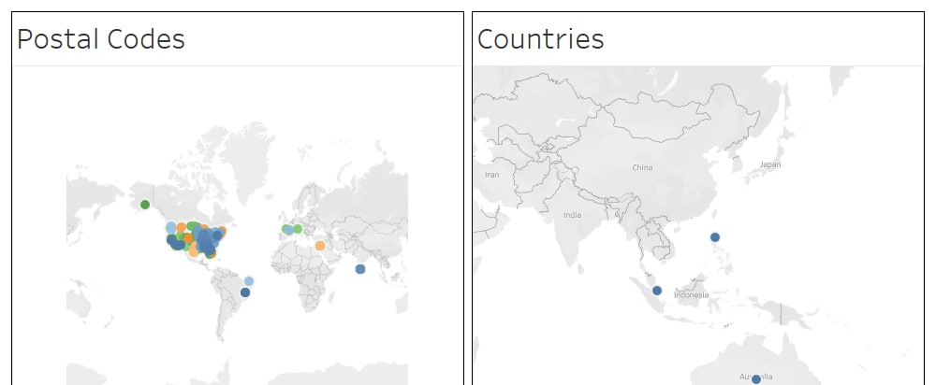
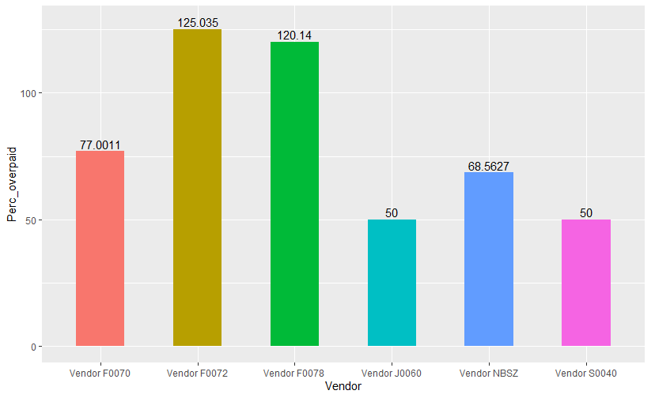
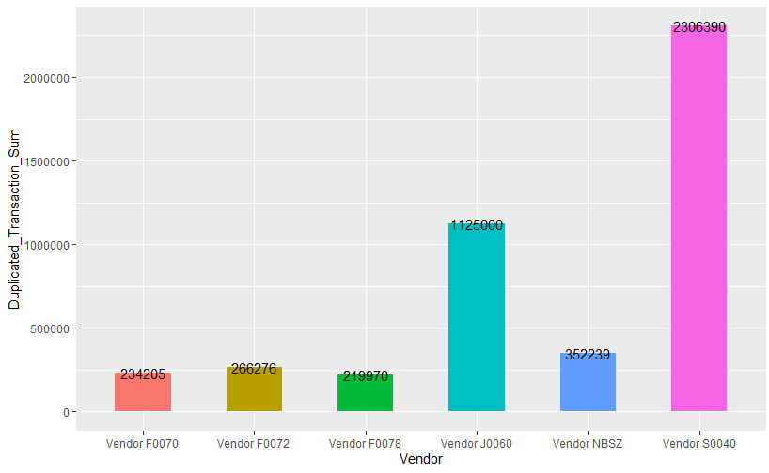
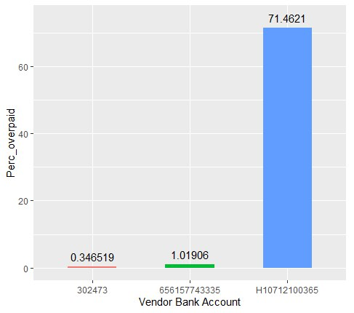
Accounts Payable Fraud
Billing Fraud
Duplicate Invoice Payments
Accounts creation for invoices for goods and services that were either not delivered, or payment were taken for the individuals themselves. Anomalies in Billing Information, where the postal code and country reflected were different
Fictitious payments for items that were never purchased. or expenses that may be overstated to external vendors or external accounts. Data investigation made based on percentage overstatement of the transaction flow figures (in SGD$) relative to actual transactional details (Unique data that appeared once). The top 6 vendors for percentage overstatement and duplicated transaction sum are as follows:
Cash outflows reached areas highly related to Terrorism and Tax-Sensitive areas, such as Middle East and Americas
Possible layering and placement of cash in Anti-Money Laundering
Sum of Duplicated Flow Transaction:
SGD$ 6,079,815
(16.88% of total transactions)
Duplicated Accounts: 125
(> than 50% of Vendor accounts (53.65%))
Overpayments/ Overbilling
Bank account H10712100365 reflected the highest percentage overpayment for settled transactions (71.46%) and highest transaction sum of $ 19,874,175.59.
As these financial figures are obtained from the “Payments” Sheet, they will be deemed as “Unrecoverable/Bad payments”.
Vendor S0040
Percentage overpayment: 50%
Duplicated transactional sum: SGD$2,306,389 Overpaid
Vendor NBSZ
SGD$352,238.6 overpaid , 68.56% overpaid
Employee’s bank account was disguised as a vendor→ statistical correlation of Fraud.
The accounting discrepancies and fictitious payments can signal possible money laundering within the bank involving external transaction accounts.

Slide 17
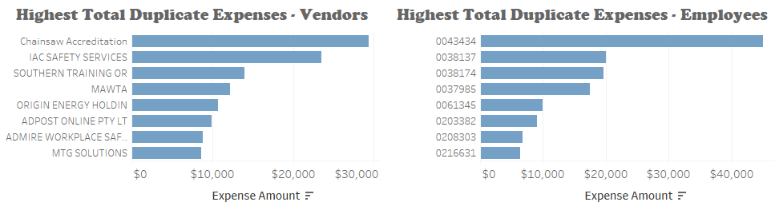
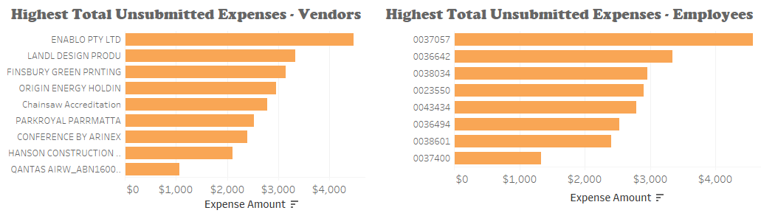
Credit Card Fraud
Duplicated Transactions
Personal Expenses
3524 instances of duplicated transactions amounting to $418,477.7 were found .The duplicated transactions involved multiple employees as well as vendors.
Assumption:
The team considers all duplicated transactions to be relevant in our fraud analysis
No data entry error that would cause duplicates
4,617 instances of credit card spending was done during leave days. The suspected personal expenses amount to $1,433,525.70 and involved multiple employees.
Assumption:
All employees are not allowed to use their corporate card while on leave
No permission granted for employees to override assumption 1
No Transaction Time – All spending on leave days are relevant
Instances
401 employees and 568 vendors involved in potential fraud.
103 instances of unsubmitted claims for credit card transactions were also present.
Instances
847 Employees

Slide 18
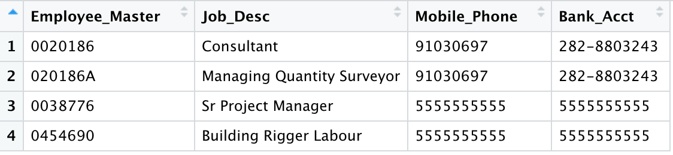
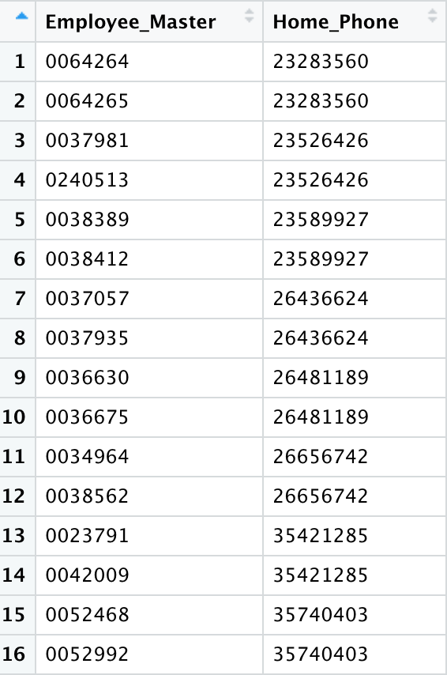
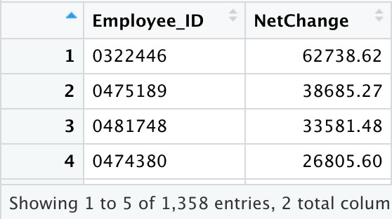
Payroll Fraud
Ghost Employee Fraud
Pay Rate Alteration/Advance Fraud
Ghost Employees are non-existent employees entered into the payroll where another employee receives income from. In this section, 3 key identifiers of each employee is looked into to highlight potential ghost employees.
Pay Rate Alteration Fraud occurs when an employee with access to the payroll system alters the pay rate for some employees.
Advance Fraud occurs when an employee draws advances but attempts to avoid payment in several ways.
Assumption/Limitations:
In this case, since there are no hourly-paid employees, monthly changes is highlighted for further testing.
Advance is given due to the erratic nature of some monthly-paid employees. However, there are no information on advance given/paid outside of the period. Therefore, totality of changes is tested.
Bank Account & Mobile Number
Home Phone
Instance 1 & 2
Assumption: Additional ”A” was added to the end of the Employee ID which may signify a promotion/rotation
Implication: No salary pay-outs for these 2 instances
Assumption:
Employees can have multiple bank accounts but only 1 home phone.
Home Phones entered are accurate and valid
Some Home Phone numbers including “8999” were excluded.
Instance 3 & 4
Both Employees IDs were paid during the same period
Assumption: One of them is Daily-Paid while another is Monthly-Paid. Employees with multiple roles/payment types should be paid to a single employee account for tax and accountability purposes.
Implications:
0038776 is the ghost employee: $121, 208
0454690 is the ghost employee: $763.05
Instances of Irregularities: 1358
Implication: Total $582,041, Single Employee Net Change up to $62,738.62 overdrawn.
Conclusion: While there are both overdrawn salaries and employees who had a net negative salary, the limitations of the dataset meant that it is hard to ascertain fraudulent pay rate or advances activity possible reasons may include bonuses, commissions, advances etc.
Conclusion: 038776 and 045490 is likely to be a ghost employee, further investigation required.
Conclusion: Inconclusive due to multiple instances, further investigation required.

Slide 19
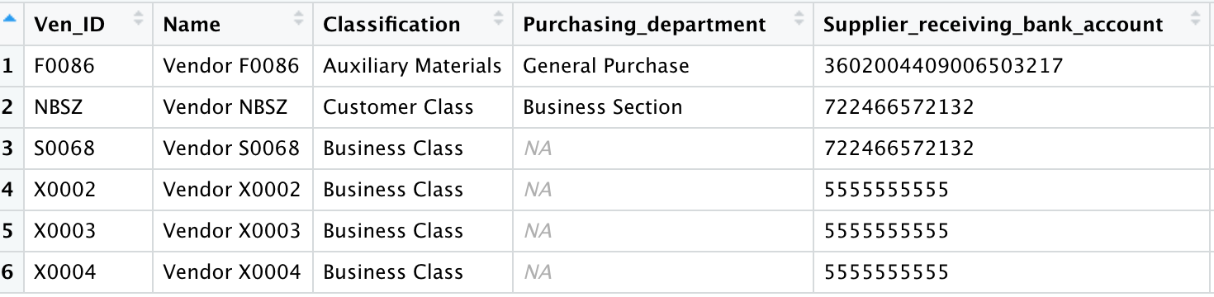
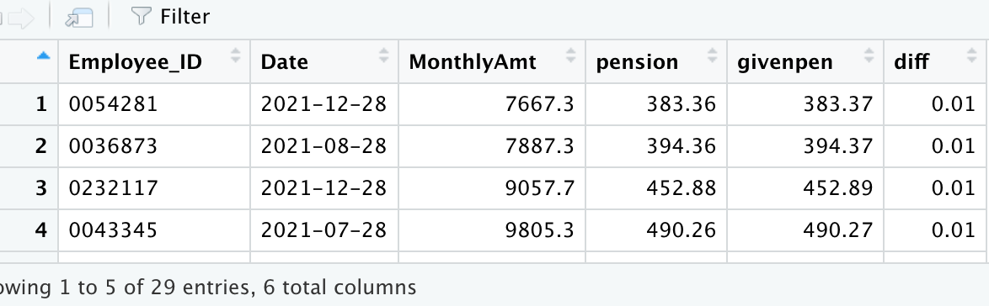
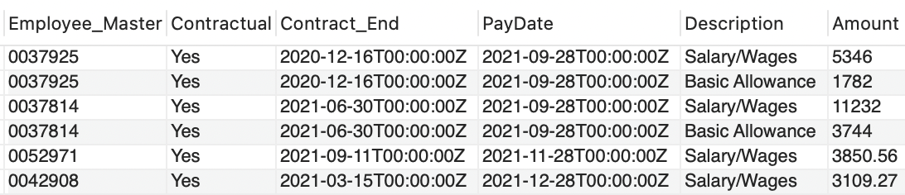
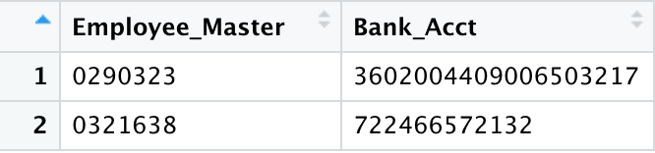
Payroll Fraud
Unauthorised Employee Fraud
False Vendor Fraud
Pension Allocation Fraud
Unauthorised Employee Fraud occurs when an employee that should not have been paid is receiving a salary pay-out. In this case, contractual employees are investigated if they are paid beyond the end of their contract.
Assumption:
38 Days used as a control as a buffer for last-month-salary – MOM requires employees to be paid within 7 days of end-of-period (MOM, n.d.) . Given that all employees have different contract end dates and the financial period is unknown to employees, 1 month is used as the buffer. Therefore, 31 Days + 7 Days = 38 Days.
Pensions are excluded as it can be paid beyond.
False Vendor Fraud occurs when an employee purchases from an entity owned or connected to them, possibly charging for the product/service above market value resulting in a conflict of interest.
Occurs when employees draw pension inaccurately or when they are not supposed to possibly instigated by external syndicates.
Assumption:
Negative Pension refers to pension members making contributions to their scheme
Allocation is made on calculation of Net Salary.
Instance 1, 2 & 3
3 Instances of 2 Unique Vendor Bank Accounts are the same as 2 of the Employees
Implications:
F0086 = $2,340,342
NBSZ = $1,744,018
Instances
392 Employees were paid beyond 38 days of the end of their contract. Some as late as 9 months later as seen in instance 1
Implications:
Total = $10,222,561.24
29 Instances of Rounding Error
Instance 4,5 & 6
Same bank account number as Ghost Employee Identified
Implication: No payments made, possible testing account or out of period.
Conclusion: With the lack of information, the number and cost of unauthorised employees is alarming and should require further attention.
Conclusion: the 2 fake vendors had claimed large amounts of money from Lumbago Edge Bank, and NBSZ has been highlighted in the Expense Reimbursement Fraud Analysis as well.
Conclusion: No conclusive pension allocation fraud found

Slide 20
07
Recommendations
Remediations and Resolutions

Slide 21
Minimising Billing Fraud Occurrence
Monitoring of payment transfers to regions out of geographical operations to prevent layering and placement of cashflows in Money Laundering. This increases accountability and operational trade outflows for the Bank
Counter-terrorism financing should also be noted, and respective countries should be on the blackout list of the Bank, as qualitative analysis showed that there were payments made to the Iraqi region, despite the country being recorded as Philippines.
This is important as Money laundering can lead to negative effects such as reputation loss to the Bank.

Slide 22
Negating Expense Reimbursement Fraud
With 16.88% of Total flow dollars being duplication transactions, this is alarming for the bank as it is over $6 million and rectification of the transactions (reversal of expenses) from external vendors will be labor-consuming and challenging to overcome, as the geospatial data shows that expenses have been submitted and transferred to areas of high risk and terrorism.
To overcome this issue, the team has outlined three methodologies that Lumbago Bank can employ in process automation and limit losses on expense reports:
Tighten Approval Processes with Automation and AI
Only 32% of companies automate links between expense reports and process claiming
Require all finance outbound processes to require multiple authentication. (Integrate expense, subscription, procurement and invoices
Implement use of Corporate card with greater control
Query each card individually to ensure that payments are legitimate
Review credit activity reports on a monthly basis from issuing company.
Compare credit activity to determine excessive transaction to unknown vendor and transaction location
Formal review process and routinely question expenditures
Managerial individuals or special AML department set up to review employee reports, expense to perform cursory reviews frequently.
Routinely question expenditures that look extraordinary (large amounts or duplicated transactions with large percentage difference)

Slide 23
Deterring Internal Payroll Fraud
Tighten Approval Processes with Machine Learning/AI
Use of Machine Learning to identify possible anomalies for further investigations.
E.g. Payroll data → Machine Learning System → Manager/Director Approval
Limit Vendor Through Partnerships
Securing partnerships with limited vendors.
Allow expense reimbursement only from limited vendors.
Regular audit/review of vendors – including credit review of vendors
This ensures that there are no conflict of interest with vendors and the regular review ensures financial survivability of suppliers.
Fixed Payment
GIRO/SWIFT set-up to remit fixed payments to certain bank accounts
Prevents double crediting to the same account
Prevents pay rate alteration due to fixed amounts.
Ensures efficiency of payment process.

Slide 24
Credit Card Fraud Prevention
Revise spending and claims policies
Limit the amount of expenses that can be submitted without receipts
Place limits on certain activities per person such as meals and entertainment
Put in place strict penalties for those who violate the polices
Intensify audits & Reviews
Utilize AI or machine learning techniques that can identify fraud and examine outliers to validate spending
Reviewing the company credit card statements and expense reports for accuracy
Get managers to review receipts and expenses report before submitting them for claims

Slide 25
Money Laundering Structuring/Smurfing

Slide 26
Money Laundering Process
Deposits of ‘travellers’ cheques/bank drafts in small amounts to savings account
Lack of KYC information on large cash inflow into bank accounts
Cash inflows wired through false identities from other bank accounts
Placement
Smurfing
Layering
Cash assets smuggled across borders (Large Cash outflow)
Money exchangers used to layer the large financial assets
Integration
Cash service used to ship banknotes back to public
Wire transfers to public bank accounts
Cash used to purchase material assets.

Slide 27

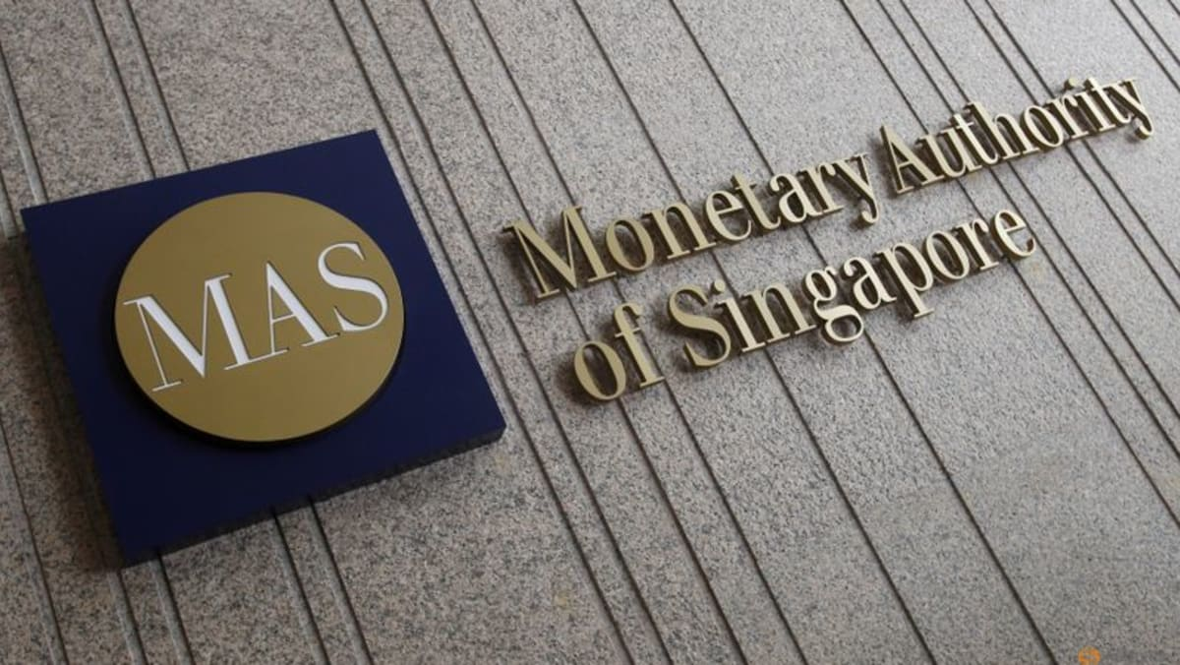
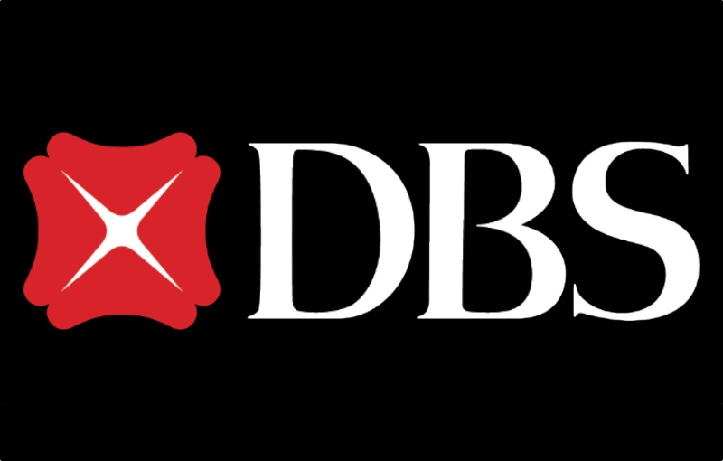
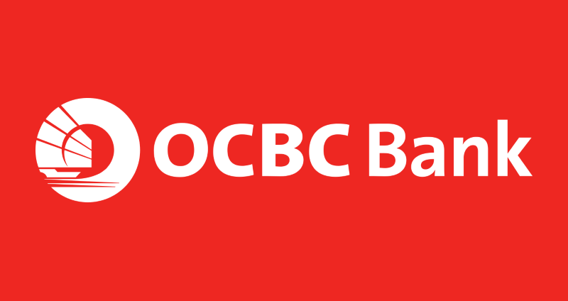
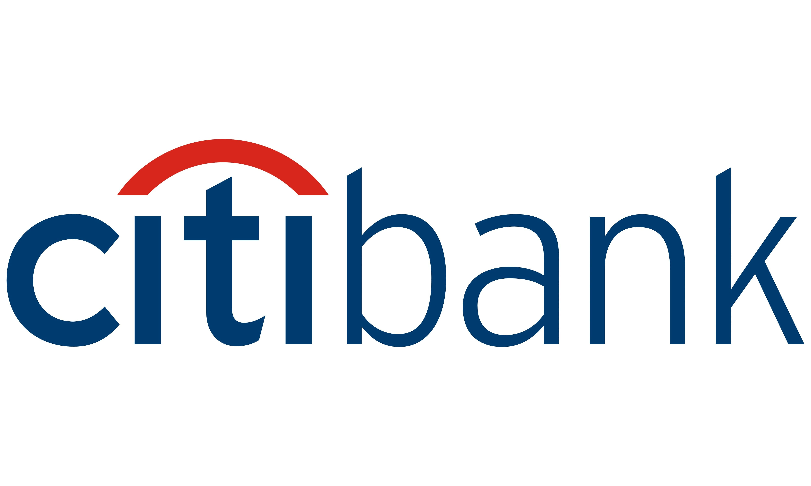
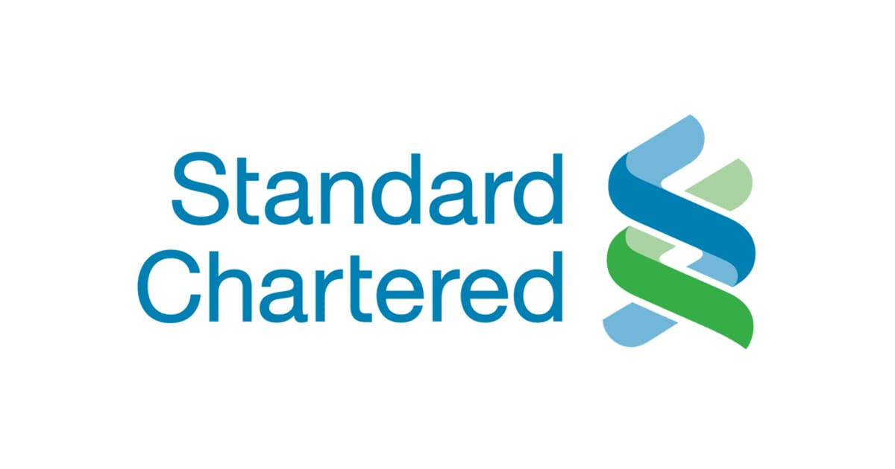


Local Regulatory Scene
MAS - NOTICE 626
Prevention of Money Laundering and Countering the Financing of Terrorism
(MAS, 2021)
Moving Forward: Central data platform to counter Money Laundering
Procedures & Requirements for Suspicious Transaction Reporting (Not exceeding 15 days of bank staff referral)
Guidelines, Explanation and Illustrations of Money Laundering Cases and Suspicious Transactions
7 Measures to identify CDD & Give Authority to Banks to Perform CDD
Requirement to include information of originator for cross-border transfers of more than S$1,500
Collaborative Sharing of ML/TF Information and Cases (COSMIC) Platform (FY2023)
MAS Partnership with 6 banks to securely share customer and transaction information where cross material risk thresholds exists
Data and risk analytics to flag out suspicious individuals/transactions
Regulatory and cybersecurity compliance to prevent data mistreatment and breach
Internal Controls and Audit department
→ Singapore Police Force – Commercial Affairs Department: Investigate Allegations of Money Laundering
→ Suspicious Transaction Reporting Office: Receives STR, Cash Movement Reports, Cash Transaction Reports
→ MAS – Anti-Money Laundering Unit: Approx. 30 Investigators
Customer Due Diligence (CDD)
Anonymous or Fictitious Account
No Bank Allowed to Open or Maintain Account
Customers with Reasonable Grounds for Suspicions based on historical activities
Bank shall not establish business relations or undertake transactions and file Suspicious Transaction Report (STR)
Payment Services Act (2022 Updates)
Licensing of Digital Payment Tokens and Services (Online Currencies) by streamlining payment gateways and services to reduce instance of utilizing online currencies for suspicious transactions
(Dow Jones, n.d.)
Notes:
MAS NOTICE 626 – Prevention of Money Laundering and Countering The Financing of Terrorism

Slide 28



Detecting Smurfs/ Structuring
Network Analytics (Framework)
Steps:
1
2
3
Identify Relationships
Build Connections
Discover Illicit / Suspicious Activities
Define the relationships between each customer
Know-Your-Customer
Frequent Transfers
Payments
Visualising the flow of funds
Scrutinising transfers made by each account
Purpose of transfers
Identify suspicious activities
Destination of funds
Discovering patterns

Slide 29
Detecting Smurfs/ Structuring
Dataset Required
Methods
Customer’s Profile
Customer’s Close Contacts
Transfer/Payment Activity
Other Banking Activities
80% Machine Learning, 20% Manual
Retrieve data in real-time
Grouping similar type of transactions
Machine Learning Models
KYC Purposes
Risk Profile
Customer Occupation, annual income
Risk of False Positives
Consistent review required
Real-time analysis of trends and patterns
Time series analysis
Recipient of Transfers
Shared Accounts
Frequency
Date & Time
Purpose
Spot anomaly between similar transactions
Identify trends within each account
Foreign Currency Exchange
Withdrawals
Deposits
Association Rules
Neural Network/Deep Learning
Notes:
Know Your Customer policies require banks to verify the customer’s name, date of birth, address, and occasionally additional information, such as occupation. Banks typically ask customers to verify their identity with ID documents when opening an account. More recently, banks are using biometric identification, such as face or voice recognition, and fingerprint scans.
Those false positive alarms are estimated to constitute more than 90% of the total alerts generated by the traditional rulebased systems commonly adopted by banks (Breslow et al., 2017).

Slide 30
QnA

Slide 31
References
https://www.stampli.com/blog/accounts-payable-fraud/types-of-accounts-payable-fraud/
https://bestaccountingsoftware.com/accounts-payable-scams/
https://thepaypers.com/expert-opinion/trust-is-hard-to-gain-but-easy-to-lose-a-banks-reputation--1249891
https://www.forbes.com/sites/edwardsegal/2020/12/14/how-to-guard-against-corporate-credit-card-and-expense-report-fraud/?sh=3650b8d7f85f
https://www.stpaulschambers.com/most-common-types-of-payroll-fraud/
https://www.accountingtools.com/articles/types-of-payroll-fraud
https://stonebridgebp.com/library/uncategorized/expense-reimbursement-fraud-ten-ways-to-protect-your-organization/
https://blog.spendesk.com/en/expense-report-process
https://www.dowjones.com/professional/risk/glossary/anti-money-laundering/singapore/#:~:text=AML%20legislation%20in%20Singapore,money%20laundering%20and%20its%20criminalization.
https://www.mas.gov.sg/-/media/MAS-Media-Library/regulation/notices/AMLD/notice-626/MAS-Notice-626---Banks.pdf
https://www.mom.gov.sg/employment-practices/salary/paying-salary#:~:text=In%20accordance%20to%20the%20Employment,without%20notice%20and%20other%20situations.
https://www.mas.gov.sg/news/media-releases/2021/mas-and-financial-industry-to-use-new-digital-platform-to-fight-money-laundering
https://www.mha.gov.sg/mediaroom/speeches/association-of-banks-in-singapore-financial-crime-seminar-2021-deepening-partnerships-to-combat-financial-crime/
https://shuftipro.com/blog/singapores-digital-payment-token-and-aml-regulations-2022-updates/#Singapores-AMLCFT-Laws-With-Respect-to-DPT-Services

